Slide 1



CSA0915 – Java Programming For Freshers
CHESS GAME
Guided By, Project By,
T. Vincent Gnanaraj P.Vigneshwaran
(Course Faculty) (192124181)
Programming in Java Artificial Intelligence & Data Science
SSE, SIMATS SSE, SIMATS

Slide 2
ABSTRACT
This Java-based chess game project endeavors to create a console application for players to engage in the classic game of chess .The user interface is designed for simplicity, relying on console commands for move input with clear instructions and feedback. The game adheres to chess Variant, including legal moves, check, checkmate, and stalemate conditions. Robust input validation prevents illegal moves, and the application manages the game state, player turns, and special moves like castling. The project incorporates error handling for Data Base unexpected scenarios. The chosen technologies include Java, emphasizing object-oriented design principles and efficient data structures.
Keywords : Chessboard, Chess Variant, Data Base

Slide 3
Introduction
Chess is a classic and strategic two-player board game that has been played for centuries, captivating minds with its depth, complexity, and strategic challenges.
It is believed to have originated in India during the 6th century and gradually spread across the world, evolving into the game.
The chessboard consists of 64 squares arranged in an 8x8 grid, with each player starting the game with 16 pieces: one king, one queen, two rooks, two knights, two bishops, and eight pawns.
The opening, middle game, and endgame phases add layers of complexity as players navigate different strategic and tactical challenges.
Chess has a rich history and has been played by notable figures throughout time, from royalty to scholars.

Slide 4
Hardware & Software Requirement
HARDWARE:
PROCESSOR: AMD Ryzen 5 4600H with Radeon Graphics
MEMORY: 8GB RAM
STORAGE: 512GB SSD
GRAPHIC CARD: IN-BUILT
RADEON GRAPHICS.
SOFTWARE:
OS: WINDOWS 10/11
JAVA: java version "1.8.0_391"
IDE: IntelliJ IDEA Community Edition
2023.3.2
Java Edition: J2SE

Slide 5
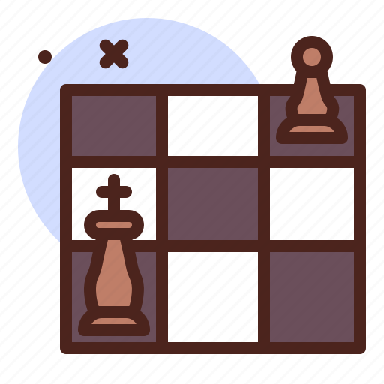
Existing System
Java Chess Libraries:
There are several Java libraries available for chess development that provide essential functionalities like move generation, validation, and game representation.
Board Representation:
Utilizes a 2D array or a similar data structure to represent the chessboard.
Each square on the board contains information about the piece occupying it.
Game Logic:
Implements the rules of chess, including how each piece moves, special moves (e.g., castling), and end-game conditions (checkmate, stalemate).
Manages the state of the game, tracks player turns, and enforces the rules.
Error Handling:
Includes mechanisms to handle unexpected situations or invalid moves gracefully, preventing crashes and providing informative error messages.

Slide 6

Proposed System
The proposed chess game system in Java aims to deliver a comprehensive and engaging gaming experience.
The system will feature a graphical user interface (GUI) built using JavaFX, providing an platform for players to interact with the game.
To enhance the single-player mode, a chess engine like Stockfish will be integrated for generating computer opponent moves.
The GUI will support drag-and-drop functionality on the chessboard, offering a seamless and immersive gameplay experience .For versatility, the system will provide both player vs. player (PvP) and player vs. computer modes, with multiple difficulty levels for the computer opponent in mode.

Slide 7
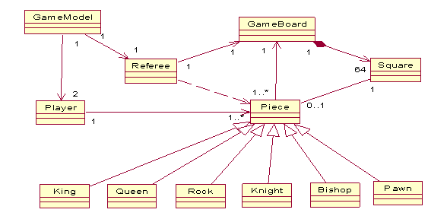
Architecture

Slide 8
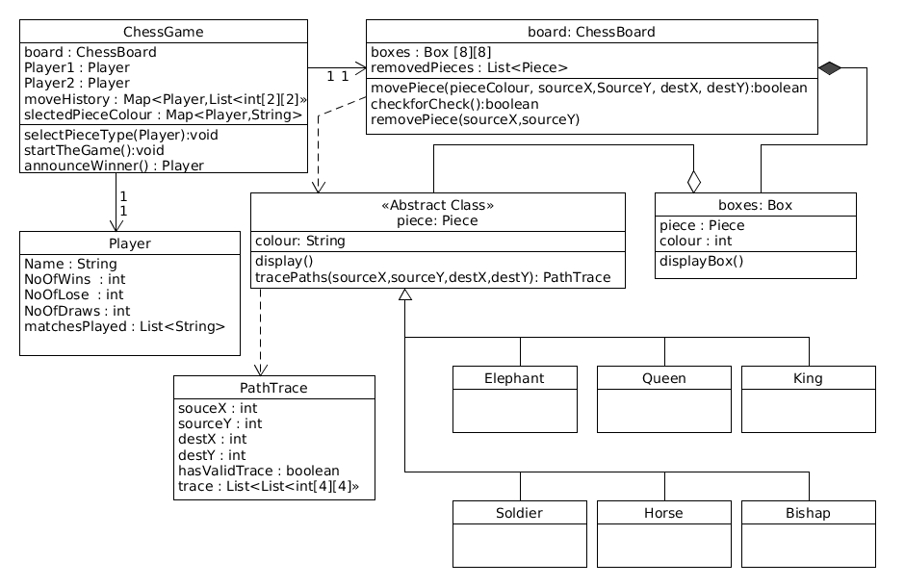
Design

Slide 9
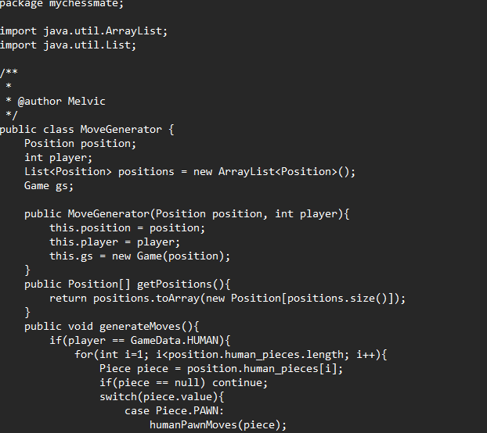
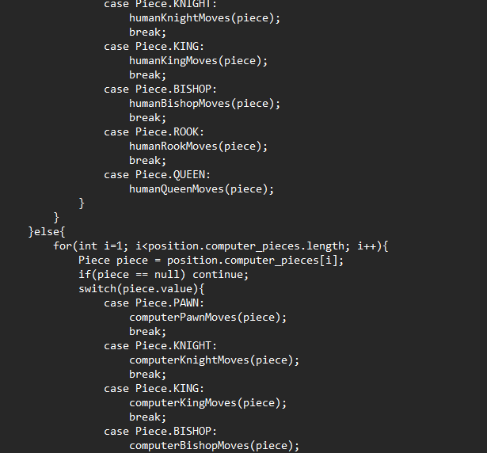
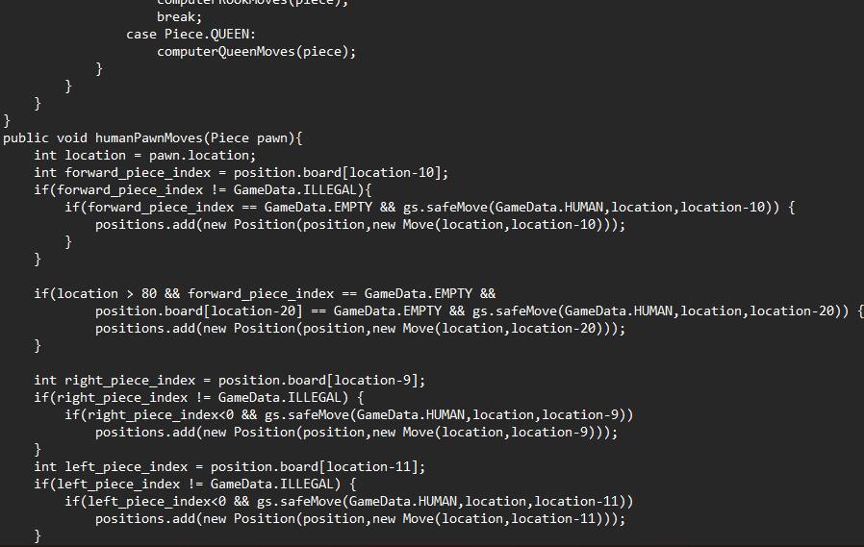
Coding

Slide 10

Testing
1.Integration Testing :Test how different components interact with each other .Verify that the interactions between pieces, the board, and the game logic are correct.
2.Game Logic Testing :Test the overall game logic to ensure that the game progresses correctly .Simulate different game scenarios and verify that the game state is consistent with the rules of chess .Test for check, checkmate, stalemate, and other game-ending conditions.
3.User Input Testing :Test user input handling to ensure that the game responds appropriately to player moves .Verify that the input validation works as expected.

Slide 11
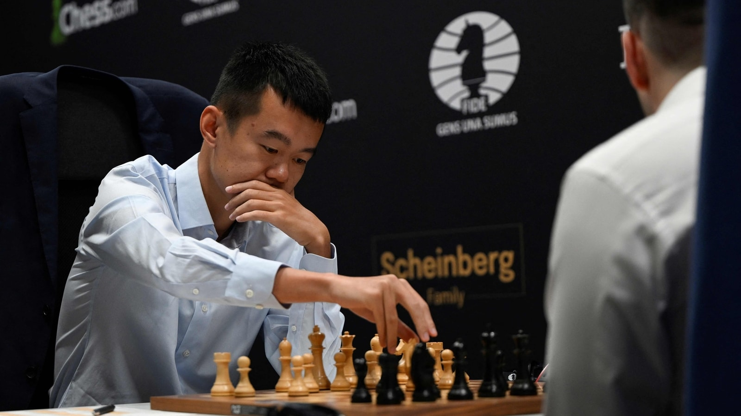
Implementation
Implement Move Validation :Define rules for each piece's valid moves based on its type Consider factors like piece blocking, capturing opponent pieces, and special moves (e.g., castling).
Implement Player Turns :Develop a mechanism to alternate turns between players .Allow each player to input their moves.
Enforce Game Rules :Implement the core game logic to enforce the rules of chess .Include conditions for check, checkmate, stalemate, and draws.

Slide 12
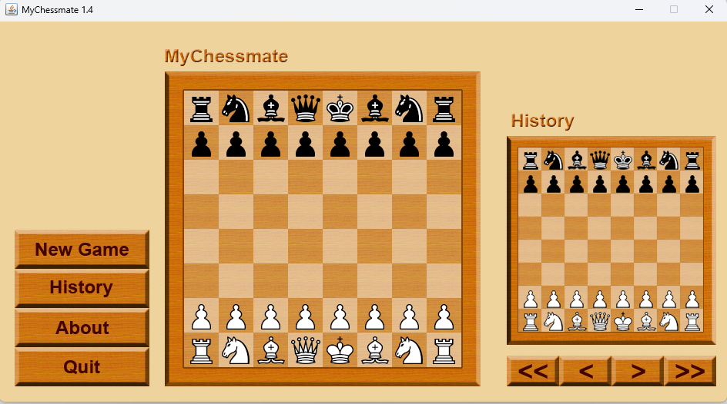
Final Output

Slide 13
Future Scope
Regularly release updates to address any bugs, improve performance, and add new features based on user feedback.
Integrate with external APIs to provide real-time chess news, updates, or analysis from reputable chess sources .Include social media integration for sharing game results and achievements.
Introduce tournament modes where players can compete against each other in structured competitions .Include challenge modes with specific objectives or rule variations.
Implement accessibility features to make the game inclusive for players with disabilities Include options for customizable font sizes, screen readers, and color contrast.

Slide 14
CONCLUSION
In conclusion, developing a chess game in Java offers a platform for creating an engaging and educational experience for users. In the rapidly evolving field of game development, staying responsive to user feedback, integrating new technologies, and incorporating innovative features will contribute to the sustained success and popularity of the chess game. Whether for entertainment or learning purposes, a well-implemented chess game in Java has the potential to provide a rich and enjoyable experience for players of all skill levels.

Slide 15
REFERENCE
[1] P. Somaskandhan, G. Wijesinghe, L. Bashitha, 2017, “Chess Programming Wiki is a comprehensive resource that covers a wide range of topics related to chess programming”.
[2] M. Rehman, O. Shamim, S. Ismail, October 2018, an analysis of open-source chess program written in Java. It can serve as a reference for a complete chess game implementation”.
[3] M. Bailey and S. Clarke, ” Chess.com provides developer resources and an API that you can use to integrate chess functionality into your application”, vol. 05, no. 04, pp. 480-487, 2006.
[4] N. Pathak and H. Wadhwa,” This book provides insights into the principles of programming chess engines, covering algorithms and strategies used in building strong chess-playing programs”, vol. 87, pp. 55-60, 2016.

Slide 16

END

